Slide 1
How to be a good Grader.
Olivia Bailey (the best grader ever.)

Slide 2
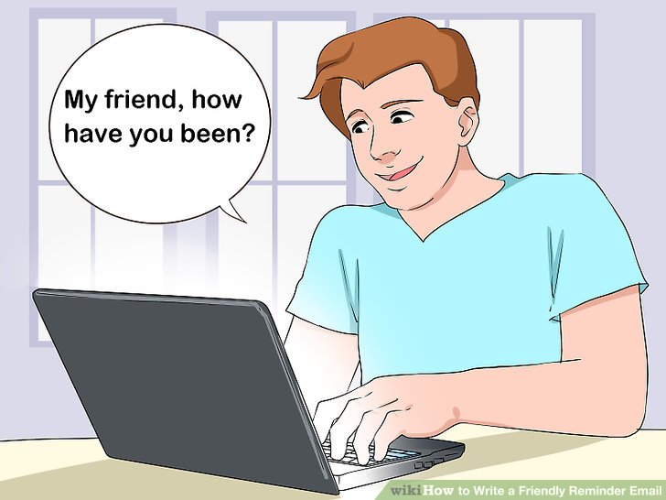
Send emails.
The kiddos love to know who is grading their work
They will be much more excited to put work into their assignments and probably will want to redo it more times if they know who you are.
Some might not ever respond to you and that’s ok, but the ones that do, really appreciate it!
AS STUDENT

Slide 3
Send Good emails. - how to write an epic email --Subject line
Please Please Please learn to add a subject line that makes sense! This is very helpful for both parties.
Be concise
State exactly what the email is about
Include your last name
EX! If they are sending you back revisions of their #4 the subject line should reader 'Number 4 Revisions (LASTNAME)'

Slide 4
Send Good emails. - how to write an epic email --Content
Greeting! Start every email with a professional greeting THEN press enter.
The meat of the email should attempt to be a compliment sandwich.
State something good they did.
The few things they need to work on and improve.
Then end by saying you 'can't wait to read their new work' or that 'they’ve got this!'.
To end the email PRESS ENTER AGAIN. Sign off with a friendly goodbye and your first and last name.
If you want to be slightly silly, I always added a fun smiley face at the end, so kids knew I was a student too. Memes are good too, BUT SCHOOL APPROPRIATE.

Slide 5
Be Nice.
They are younger than you and still learning skills.
Be kind and professional, set a good example... you never know who is going to be in A-level next year.

Slide 6
Really Read their stuff.
Yeah, it probably isn't very good BUT at least they tried and turned something in!
This is your job, and they deserve your respect of at LEAST reading the work that they have turned in.
You know what good analysis and evaluation looks like, you picked good quotes, and you know what good work should be. HELP THEM

Slide 7
Don’t be afraid to be mean.
Some of the kids are lazy but remember... THEY ARE AICE STUDENTS.
The work that they put out GOES TO CAMBRIDGE!
It is your job to make sure what they submit is not last-minute scrabbled garbage, give constructive criticism and put some force behind it... they might need that extra push.

Slide 8
Offer suggestions.
In addition to the extra push, offer suggestions that will help them improve their work.
If the analysis they submit SUCKS, tell them and then write one out for them as an example. Sometimes they just need to see the words of analysis in action to grasp the concept.
If their quote SUCKS, tell them!!! They must fix it before they can move on!!

Slide 9
Avoid them in real life.
Unless you are besties with your AS student already, don’t try to intertwine and make new friends.
This is professional, don’t follow them on insta and they shouldn’t you, you can do without the extra follower... I promise.
Still be nice to them though, some students might want to ask you questions in real life... be open to this but remember, it is not required.

Slide 10
Take your time.
They deserve your time!
Be patient and really read!!

Slide 11
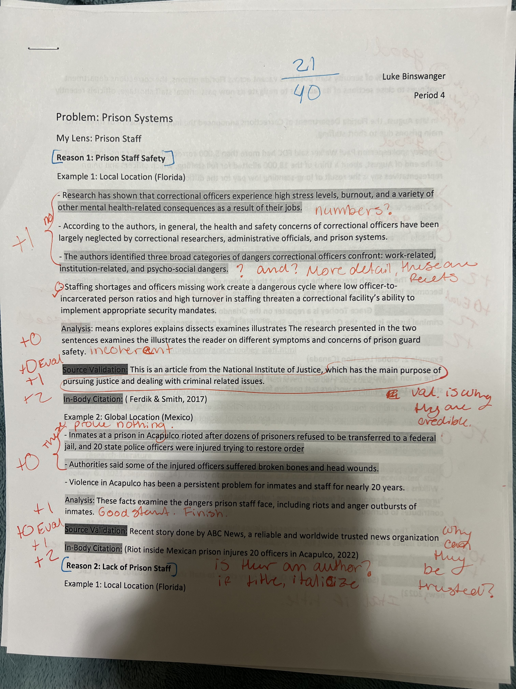
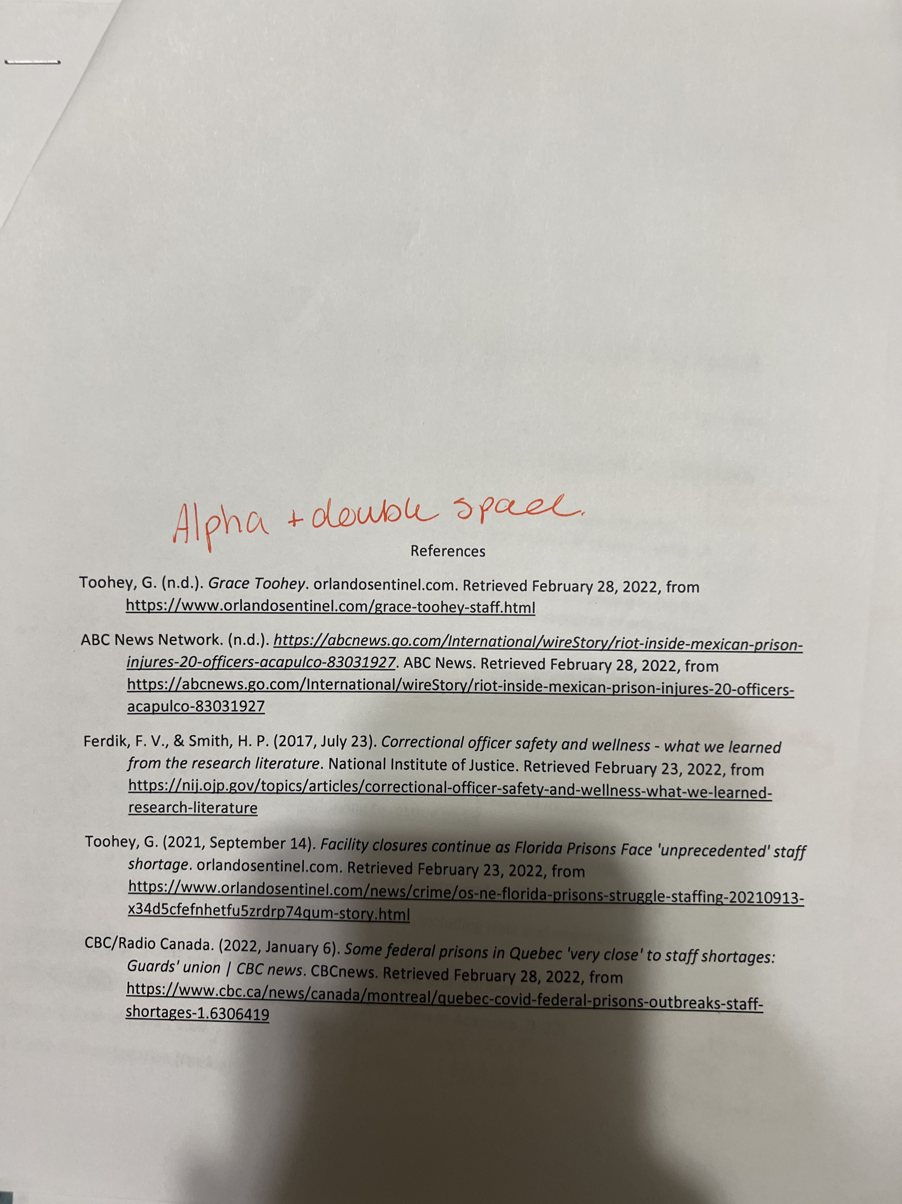
Examples of good grading. - Very in Depth.

